Slide 1
Design Thinking
+ Box Plots
Restaurant Seat
Arrangement Planning
Using distribution data — not averages — to design seating layouts around how guests actually arrive.
A DATA-INFORMED FRAMEWORK

Slide 2
Where box plots fit in the design-thinking cycle
Each stage pairs a design-thinking activity with a specific statistical read of the data.
01
Empathize
Box-plot party size, dwell time & wait time
Median + IQR reveal the “typical” guest; outliers surface edge cases
02
Define
Frame the problem from spread, not the mean
A wide IQR reframes the brief: “design for variability,” not one guest profile
03
Ideate
Brainstorm against quartile bands
Modular seating options generated per band (2-top / 4-top / combinable)
04
Prototype
Build floor plan weighted to the distribution
Table mix ratio set directly from quartile proportions
05
Test
Box-plot new data against baseline
Lower median + tighter IQR = quantitative proof the redesign worked

Slide 3
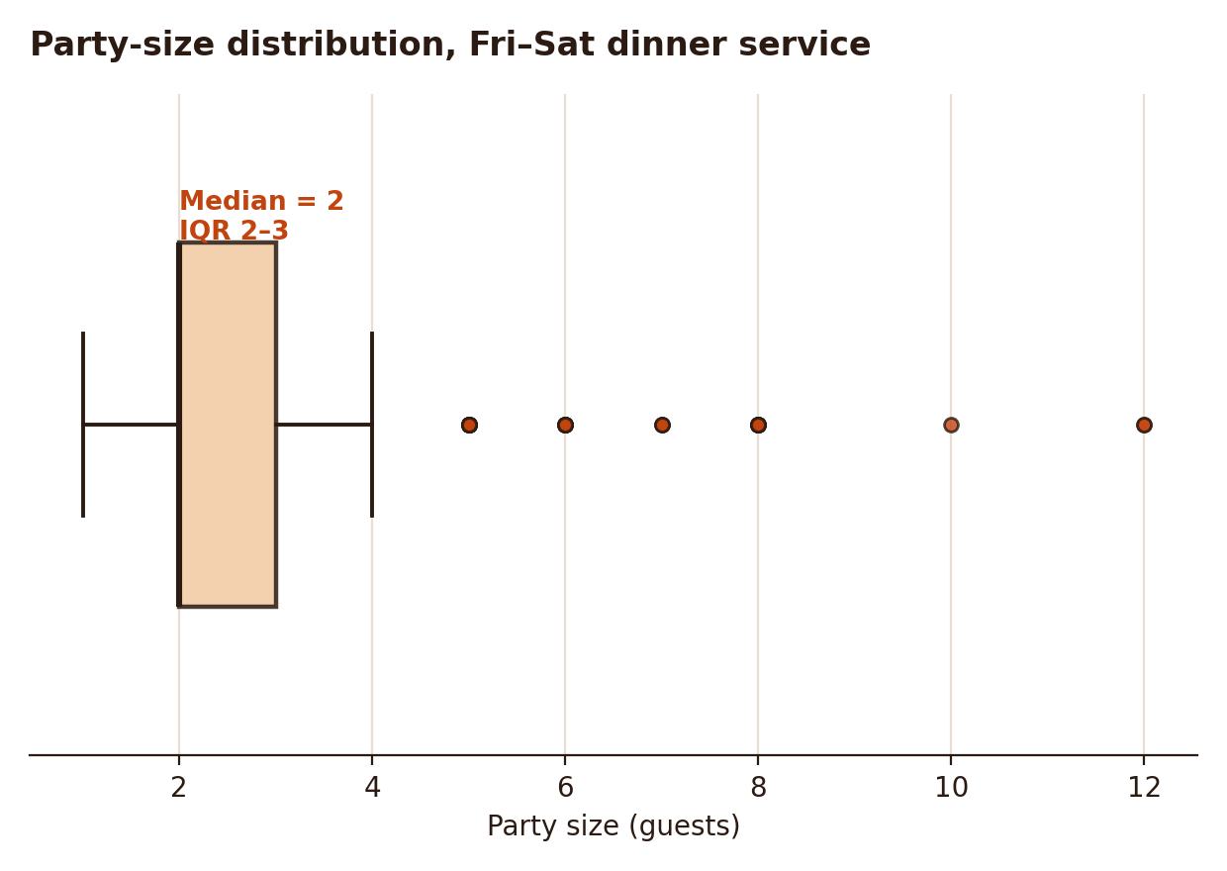
EMPATHIZE / DEFINE
What does a “typical” party actually look like?
Median party size = 2, IQR spans 2–3 — most weeknight/weekend demand is small groups
Right-hand outliers (5–12 guests) are real but rare — don't over-design around them
Design-thinking payoff: empathy work now targets the actual guest mix, not a guessed “average table of 4”

Slide 4
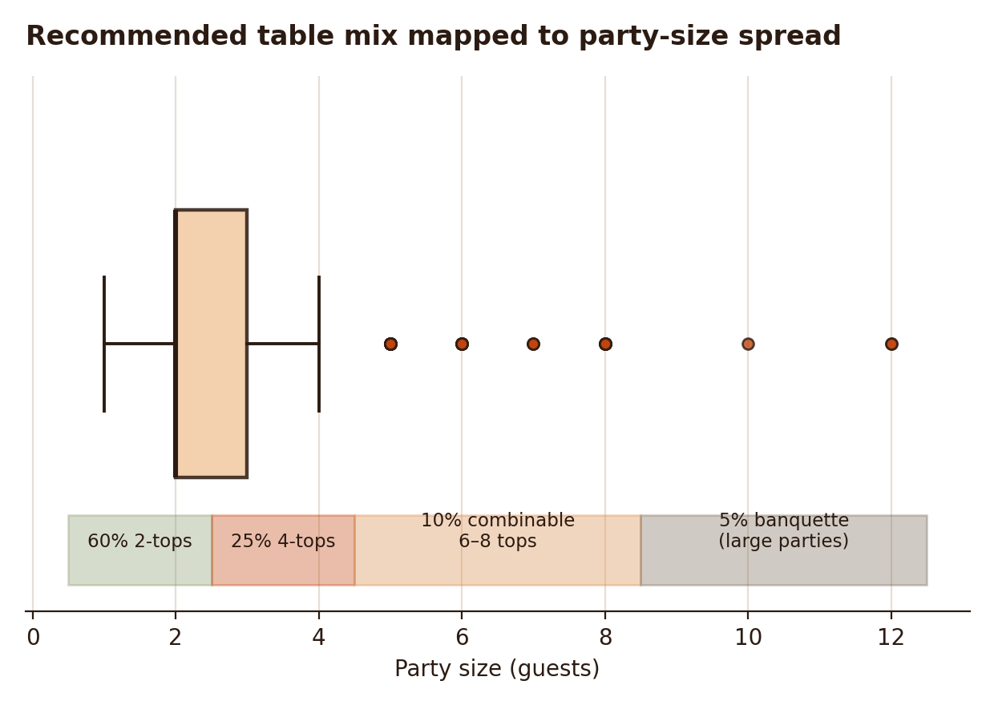
IDEATE / PROTOTYPE
Translate quartile bands into a table mix
60%
2-tops
covers the Q1–median band
25%
4-tops
covers median–Q3 band
10%
Combinable 6–8-tops
flexible for upper-quartile groups
5%
Banquette seating
absorbs rare large-party outliers

Slide 5
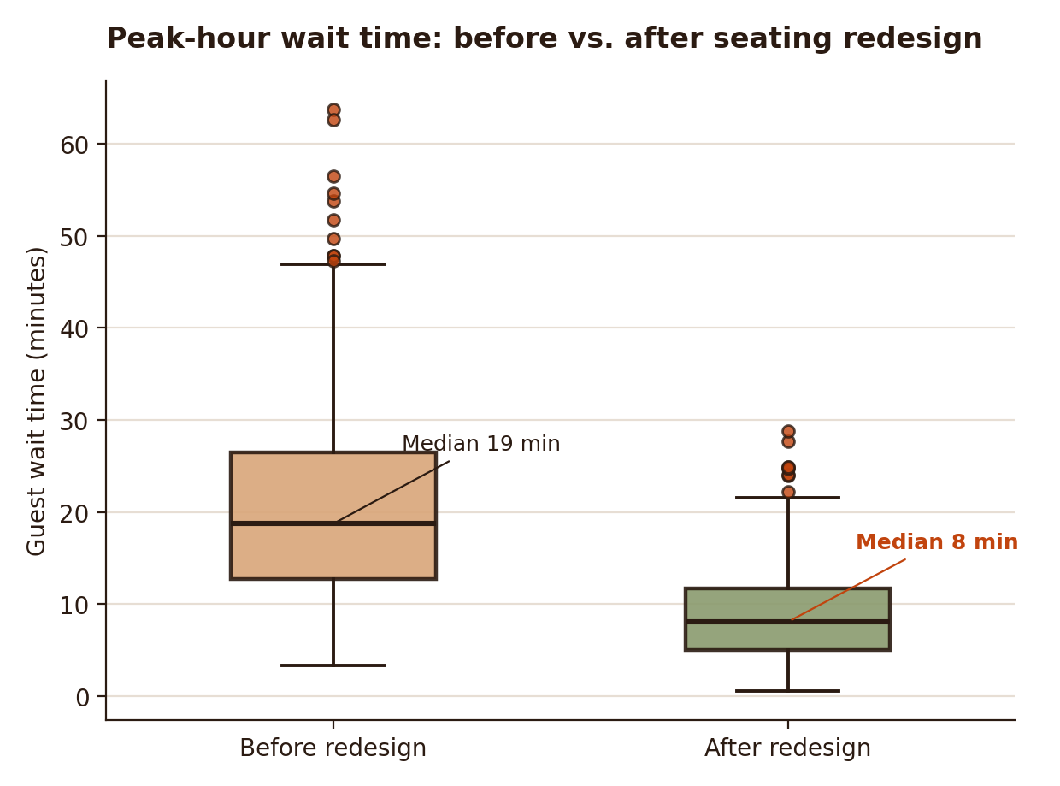
TEST
Prove the redesign worked — with the same lens
Before
Median 19 min · IQR 13–27
After
Median 8 min · IQR 5–12
Lower median = faster average seating, not just a lucky night
Tighter IQR = more predictable, consistent guest experience
Fewer high-end outliers = fewer angry walk-outs at peak hours

Slide 6
Why this beats “design around the average”
Averages hide variability
Quartiles are design specs
A mean of 3.1 guests tells you nothing about whether you need mostly 2-tops or a mix with banquettes.
Q1, median, and Q3 translate directly into a proportional table-mix ratio for the floor plan.
Outliers are a deliberate choice
Same lens closes the loop
Whisker range shows exactly how much flexible/combinable seating to reserve — and how much to skip.
Testing with the same box-plot metric as the empathize stage gives an apples-to-apples before/after comparison.

